Slide 1
Forward & deferred shading
Advanced Graphics Programming

Slide 2
Shading techniques
Forward shading
Deferred shading

Slide 3
Forward shading
It’s a direct shading technique
Objects are shaded as they are sent to render
Configure OpenGL state
Select render target (texture or Frame Buffer)
Select shader
Configure the shader (uniform variables)
Bind textures
Draw objects: glDrawArrays() / glDrawElements()
Go to 3. for as many shaders as needed

Slide 4
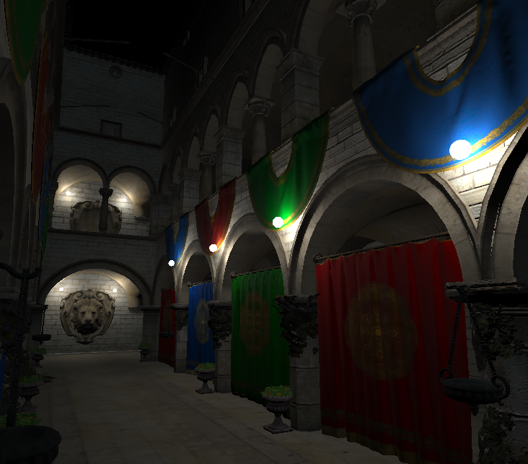
Forward shading

Slide 5
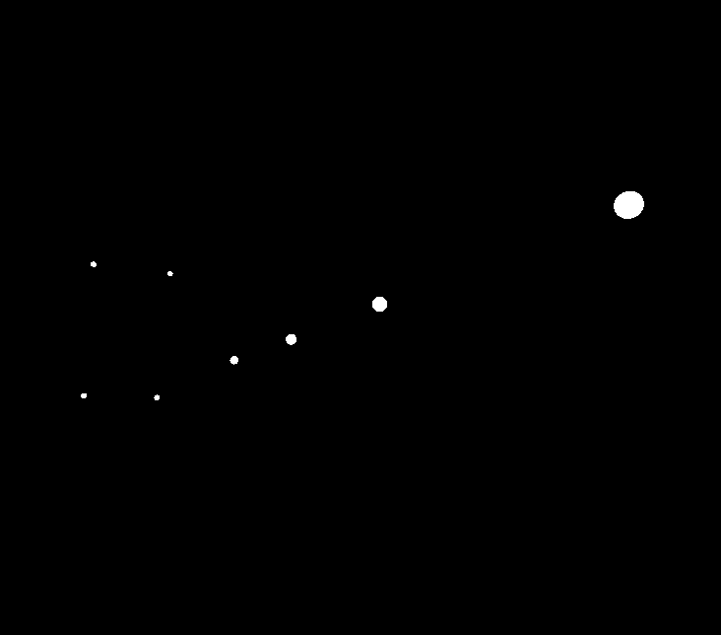
Forward shading

Slide 6
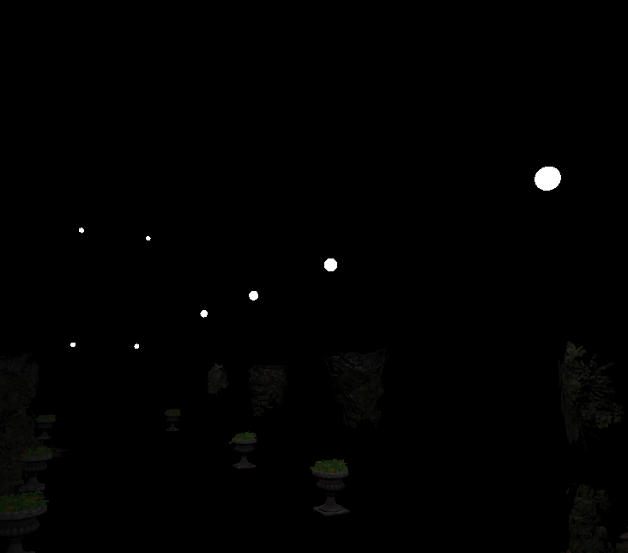
Forward shading

Slide 7
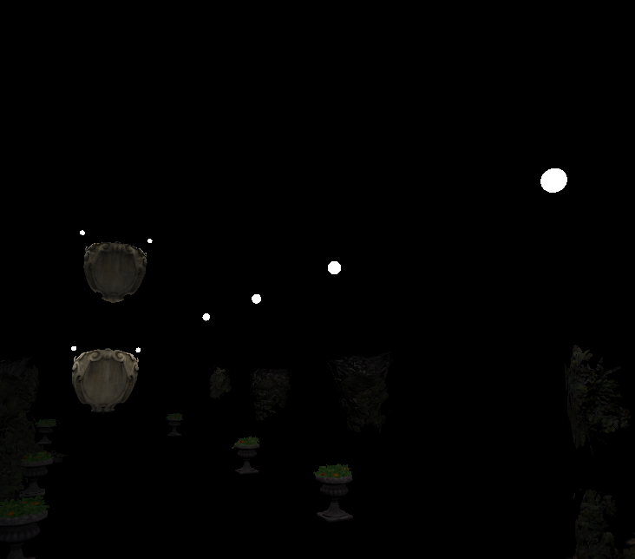
Forward shading

Slide 8
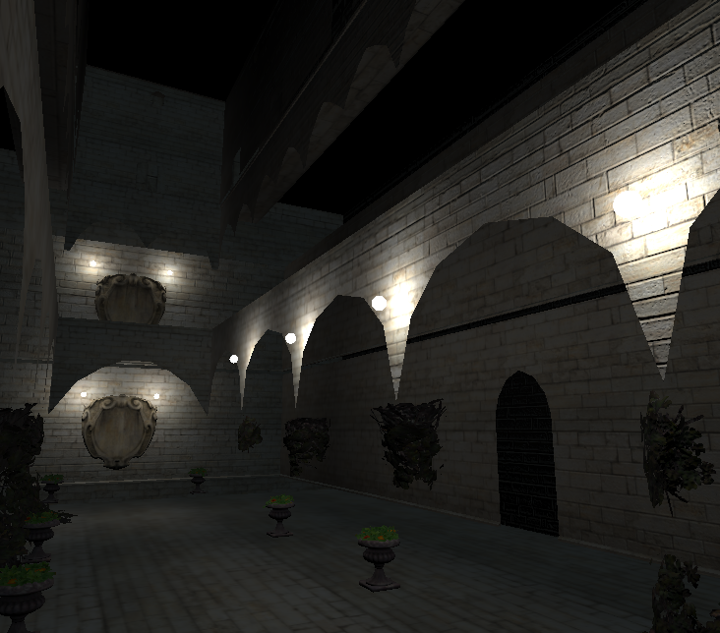
Forward shading

Slide 9
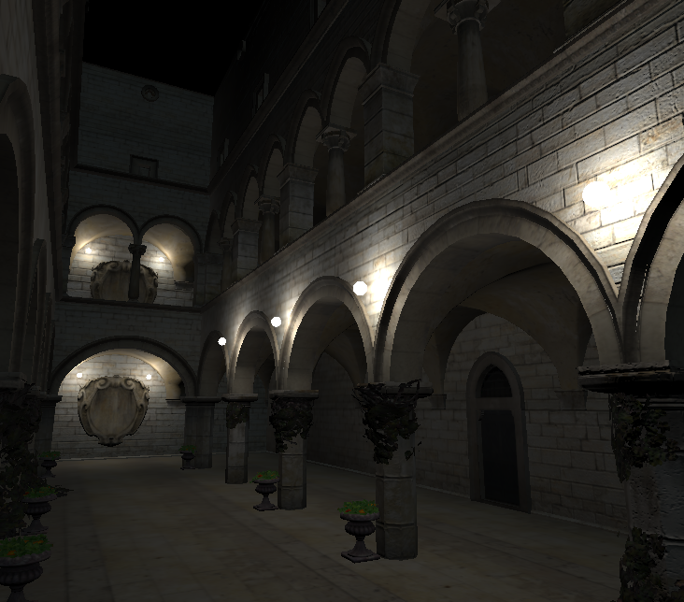
Forward shading

Slide 10
Forward shading

Slide 11
Forward shading
Straightforward
Low hardware requirements
Render targets not necessary
Each material handles its own illumination
Tons of unnecessary shading computations
Fragments that will not be shown will also be shaded

Slide 12
Deferred shading
Screen-space shading technique
Geometry pass
Scene geometry is rendered.
Shaders output models’ material properties to an intermediate G-buffer (render targets)
Shading pass
Light volumes are rendered.
The shader illuminates the scene adding light incrementally (material info from G-buffer).

Slide 13
Deferred shading
Geometry pass
Configure OpenGL state
Depth test
Select render targets (G-buffer)
Select shader
Configure the shader (uniform variables: camera, transformations, materials)
Bind textures (material attributes)
Draw scene objects: glDrawArrays() / glDrawElements()
Go to 3. for as many shaders as needed

Slide 14
Deferred shading

Slide 15
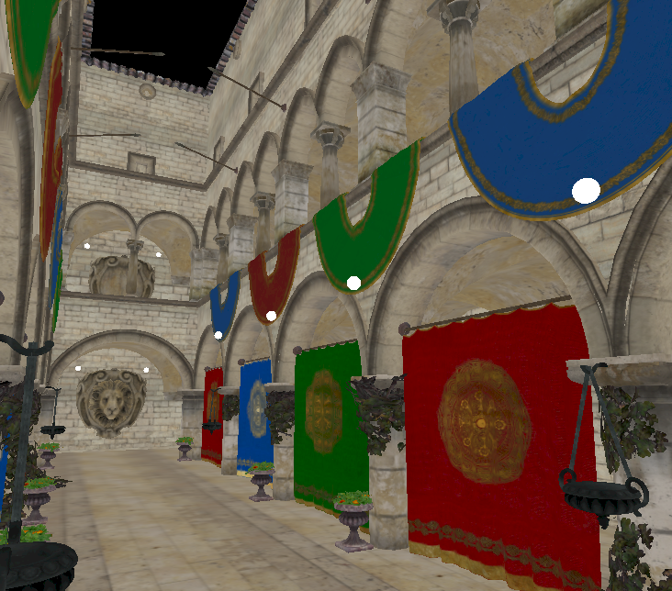
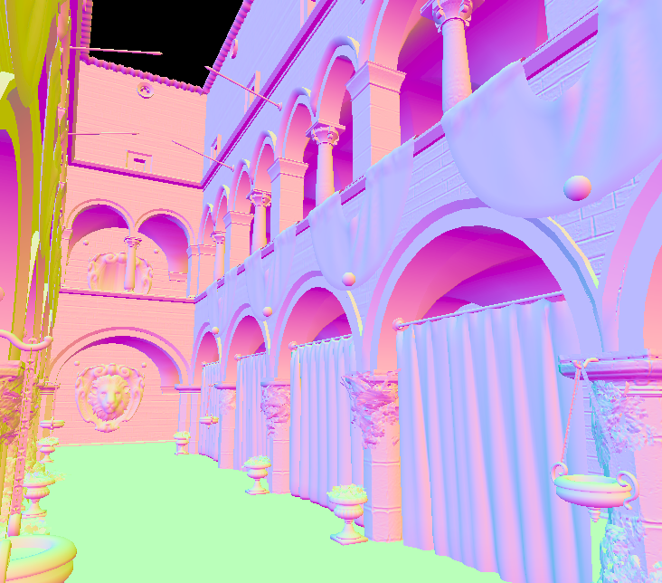
Deferred shading
Geometry pass (G-buffer): Several render targets
Others
Depth
Position
Roughness
Emissive
…

Slide 16
Deferred shading
Shading pass
Configure OpenGL state
Depth testing = true / Depth writing = false
Additive blending (glEnable(GL_BLEND) / glBlendFunc(GL_ONE, GL_ONE)
Select render target (radiance / illuminated scene)
Select shader
Configure the shader (uniform variables: camera, transformations, light attributes)
Bind textures (material attributes)
Draw light boundaries: glDrawArrays() / glDrawElements()
Spheres for far point lights
Screen-filling quads for near point lights / directional lights

Slide 17

Deferred shading

Slide 18
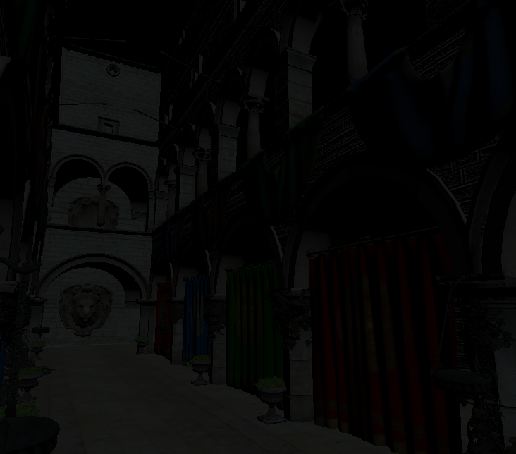
Deferred shading

Slide 19
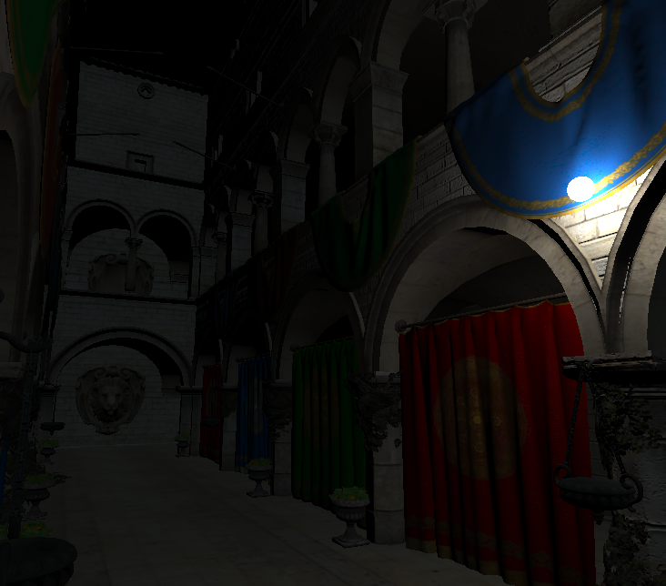
Deferred shading

Slide 20
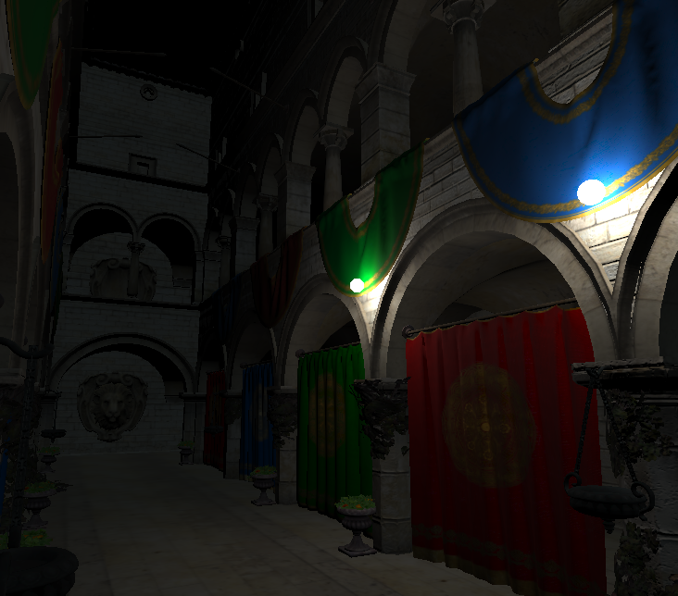
Deferred shading

Slide 21
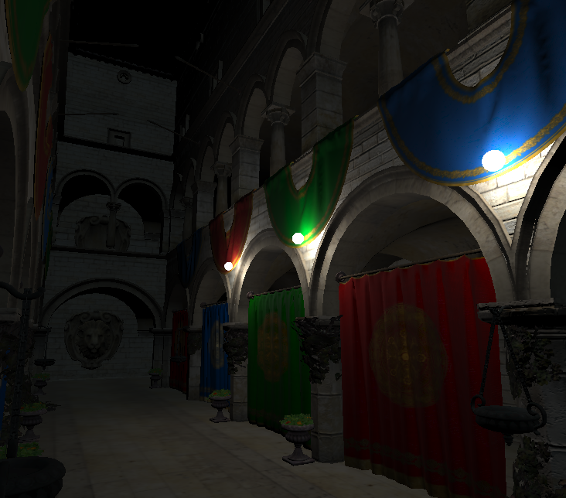
Deferred shading

Slide 22
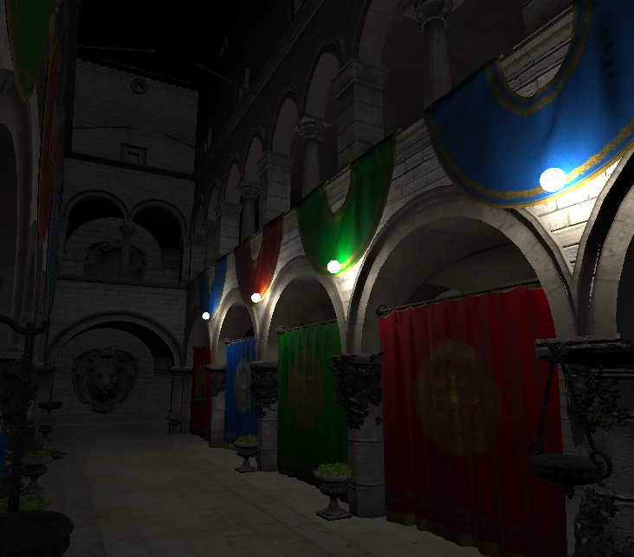
Deferred shading

Slide 23
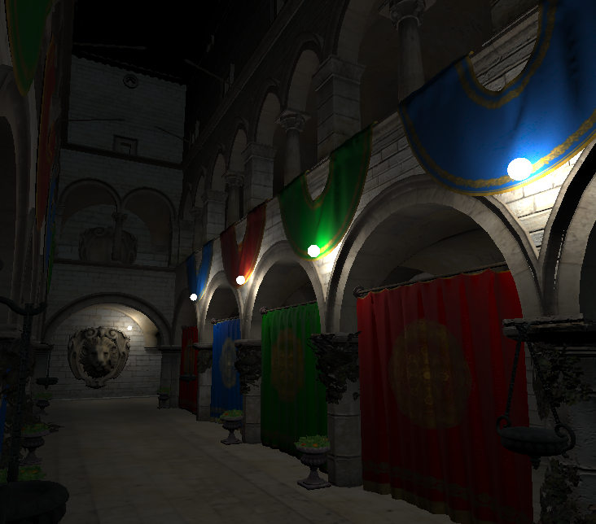
Deferred shading

Slide 24
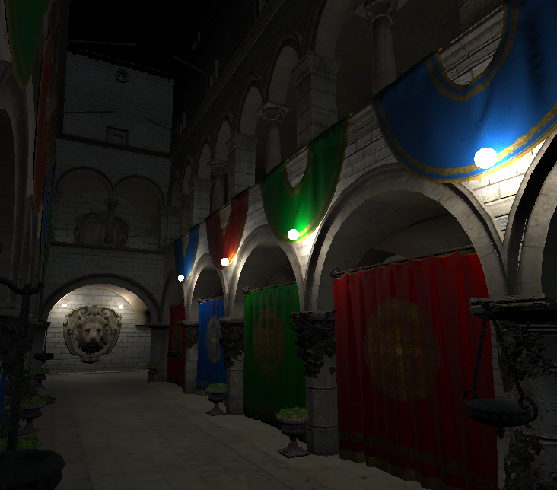
Deferred shading

Slide 25
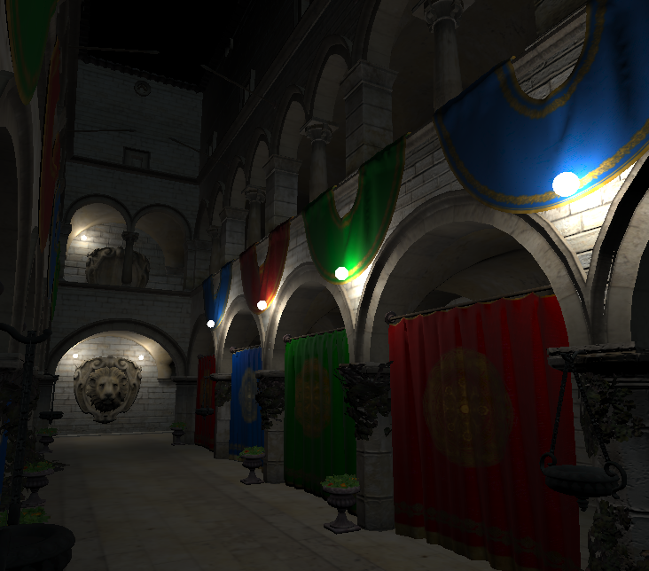
Deferred shading

Slide 26
Deferred shading

Slide 27
Deferred shading
Decouples scene geometry from lighting
Each light affects only pixels within bounds
Only rasterized fragments are processed
Some fragments may be discarded
Independent from the material pass
Standard / skinned mesh
Terrain
Relief mapping
Many lights without a significant performance hit
G-buffer available for post-processing effects

Slide 28
Deferred shading
Decouples scene geometry from lighting
Each light affects only pixels within bounds
Only rasterized fragments are processed
Some fragments may be discarded
Independent from the material pass
Standard / skinned mesh
Terrain
Relief mapping
Many lights without a significant performance hit
G-buffer available for post-processing effects

Slide 29
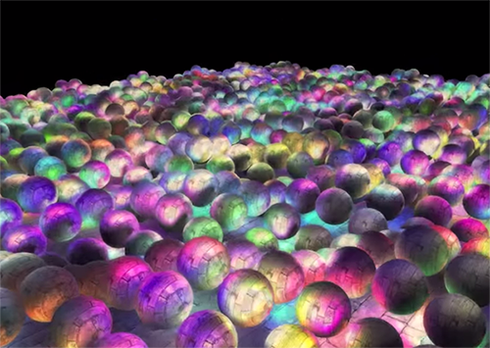
Deferred shading

Slide 30
Deferred shading
Decouples scene geometry from lighting
Each light affects only pixels within bounds
Only rasterized fragments are processed
Some fragments may be discarded
Independent from the material pass
Standard / skinned mesh
Terrain
Relief mapping
Many lights without a significant performance hit
G-buffer available for post-processing effects

Slide 31
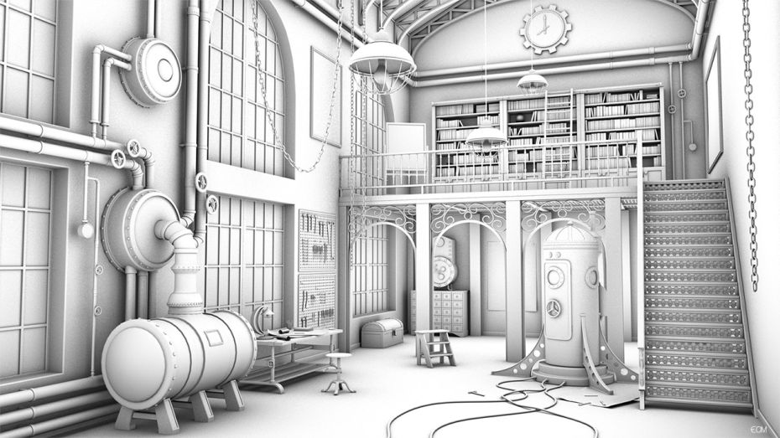

Deferred shading

Slide 32
Deferred shading
Not valid for transparent objects
Solved with back-to-front forward shading
Difficulty of using many materials
Can be done, but increases the size of the G-buffer
Eats up a large amount of memory bandwidth
Hardware anti-aliasing not supported
Interpolated subsamples for normal, tangent… produce nonsensical values.
Solutions: edge detection + blur, antialiasing techniques such as MLAA, FXAA, etc)

Slide 33
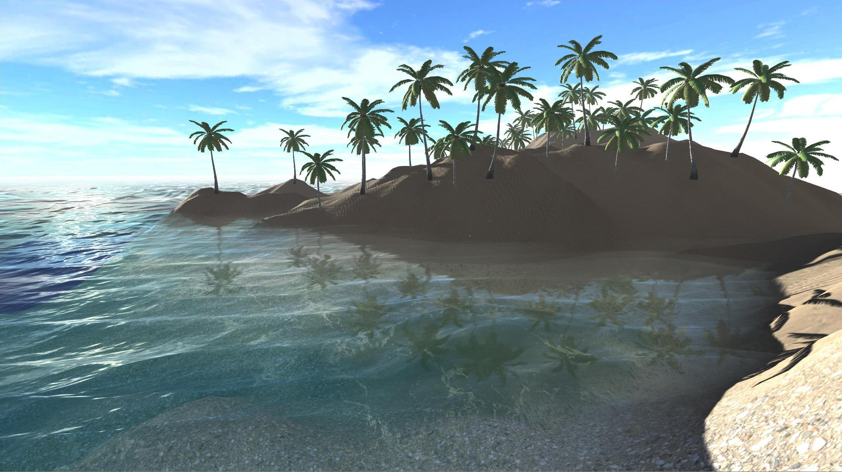
Deferred shading

Slide 34
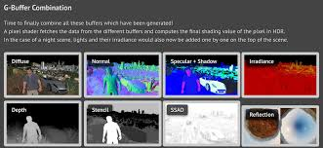
Deferred shading
Not valid for transparent objects
Solved with back-to-front forward shading
Difficulty of using many materials
Can be done, but increases the size of the G-buffer
Eats up a large amount of memory bandwidth
Hardware anti-aliasing not supported
Interpolated subsamples for normal, tangent… produce nonsensical values.
Solutions: edge detection + blur, antialiasing techniques such as MLAA, FXAA, etc)

Slide 35
Deferred shading

Slide 36
Deferred shading
Not valid for transparent objects
Solved with back-to-front forward shading
Difficulty of using many materials
Can be done, but increases the size of the G-buffer
Eats up a large amount of memory bandwidth
Hardware anti-aliasing not supported
Interpolated subsamples for normal, tangent… produce nonsensical values.
Solutions: edge detection + blur, antialiasing techniques such as MLAA, FXAA, etc)

Slide 37
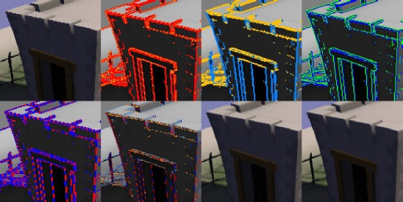
Deferred shading

Slide 38
Forward vs. Deferred
Forward
No need for render targets
Supports hardware anti-aliasing
Easy material management
Redundant lighting calculations
Few light sources
Deferred
Needs render targets
Hardware anti-aliasing not supported
Need for unified materials
Efficient lighting calculation
Many light sources

Slide 39
Which one to choose
Few lights, older hardware
Forward shading
Lots of dynamic lights, availability of modern hardware
Deferred shading

Slide 40
Combining both
You will probably end up combining both techniques
Deferred for basic scene lighting
Front-to-back order for efficiency
Take the most out of z-testing
Forward for additional geometry
Transparent objects (back-to-front order)
Guizmos / grid / UI

Slide 41

Questions?

